Slide 1
R programming for biological Databases
RETAIL SALE ANALYSIS PREDICTION
Name:-Sk.Tasneem Anjum
Regd No:-221FA14076(BI –B)

Slide 2
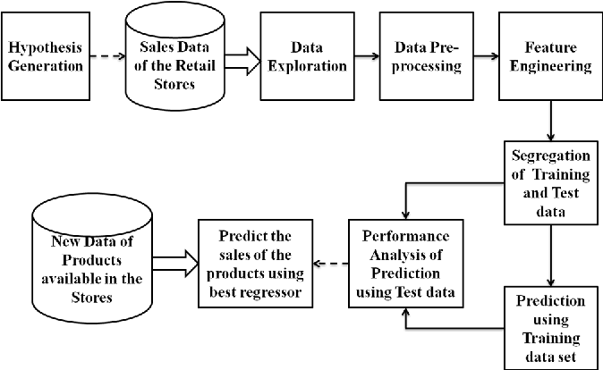
INTRODUCTION:- Introduction to Retail Sales Analysis and Prediction Retail sales analysis and prediction play a critical role in helping businesses understand consumer behavior, optimize inventory, and make informed strategic decisions. With the advent of big data, machine learning, and statistical modeling, companies can leverage historical sales data to forecast future trends, improve profitability, and streamline operations.
INTRODUCTION:- Introduction to Retail Sales Analysis and Prediction Retail sales analysis and prediction play a critical role in helping businesses understand consumer behavior, optimize inventory, and make informed strategic decisions. With the advent of big data, machine learning, and statistical modeling, companies can leverage historical sales data to forecast future trends, improve profitability, and streamline operation.
Sales Prediction in Retail
Sales prediction, or forecasting, is the process of using historical data, external factors, and statistical models to estimate future sales. By predicting demand, retailers can anticipate market trends, manage resources effectively, and avoid potential losses.

Slide 3
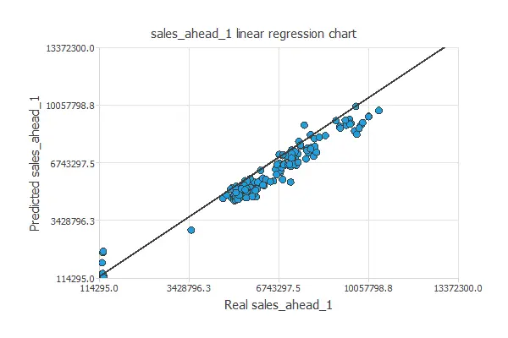
Linear Regression
Linear regression in machine learning using R involves predicting a continuous dependent variable (Y) based on one or more independent variables (X). The process begins by loading the necessary libraries, reading and preparing the dataset, and performing exploratory data analysis (EDA) to understand the data. After splitting the data into training and testing sets, the `lm()` function is used to build the regression model, which can then be evaluated using metrics like R-squared, Mean Squared Error (MSE), and Root Mean Squared Error (RMSE). Predictions are made on the test set, and visualization tools like `ggplot2` help display the relationship between actual and predicted values. This model is widely applied in real-world scenarios, such as predicting sales, forecasting trends, and understanding relationships between variables.

Slide 4
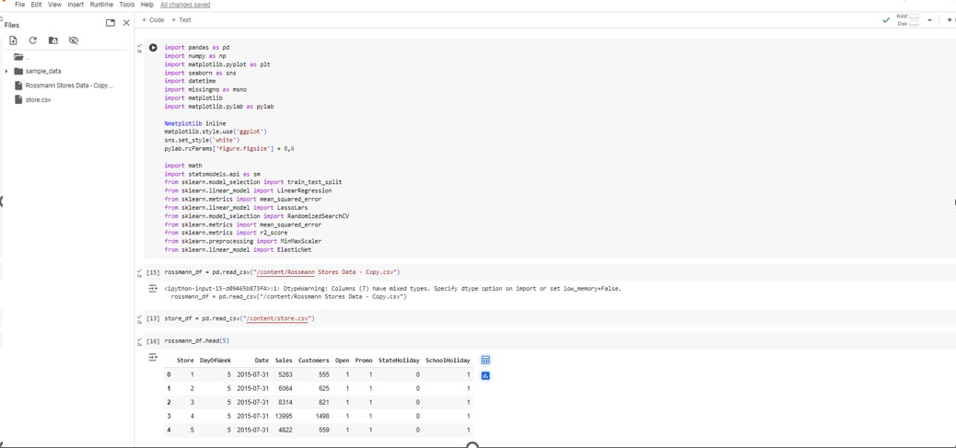

Linear Regression in Python

Slide 5
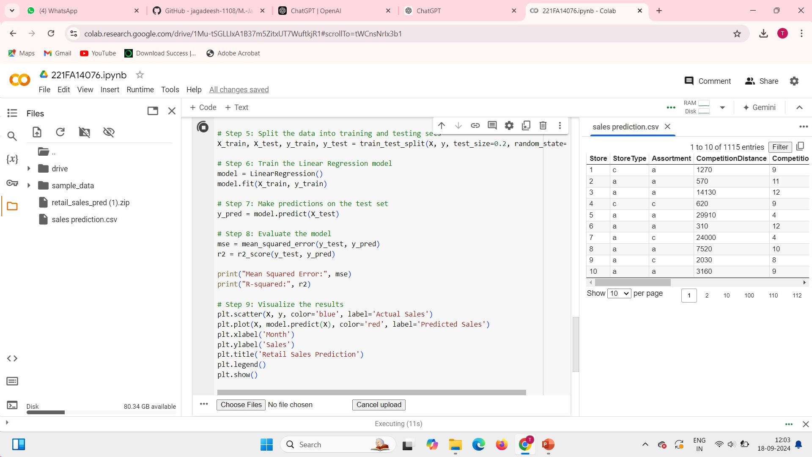
Linear Regression in Python

Slide 6
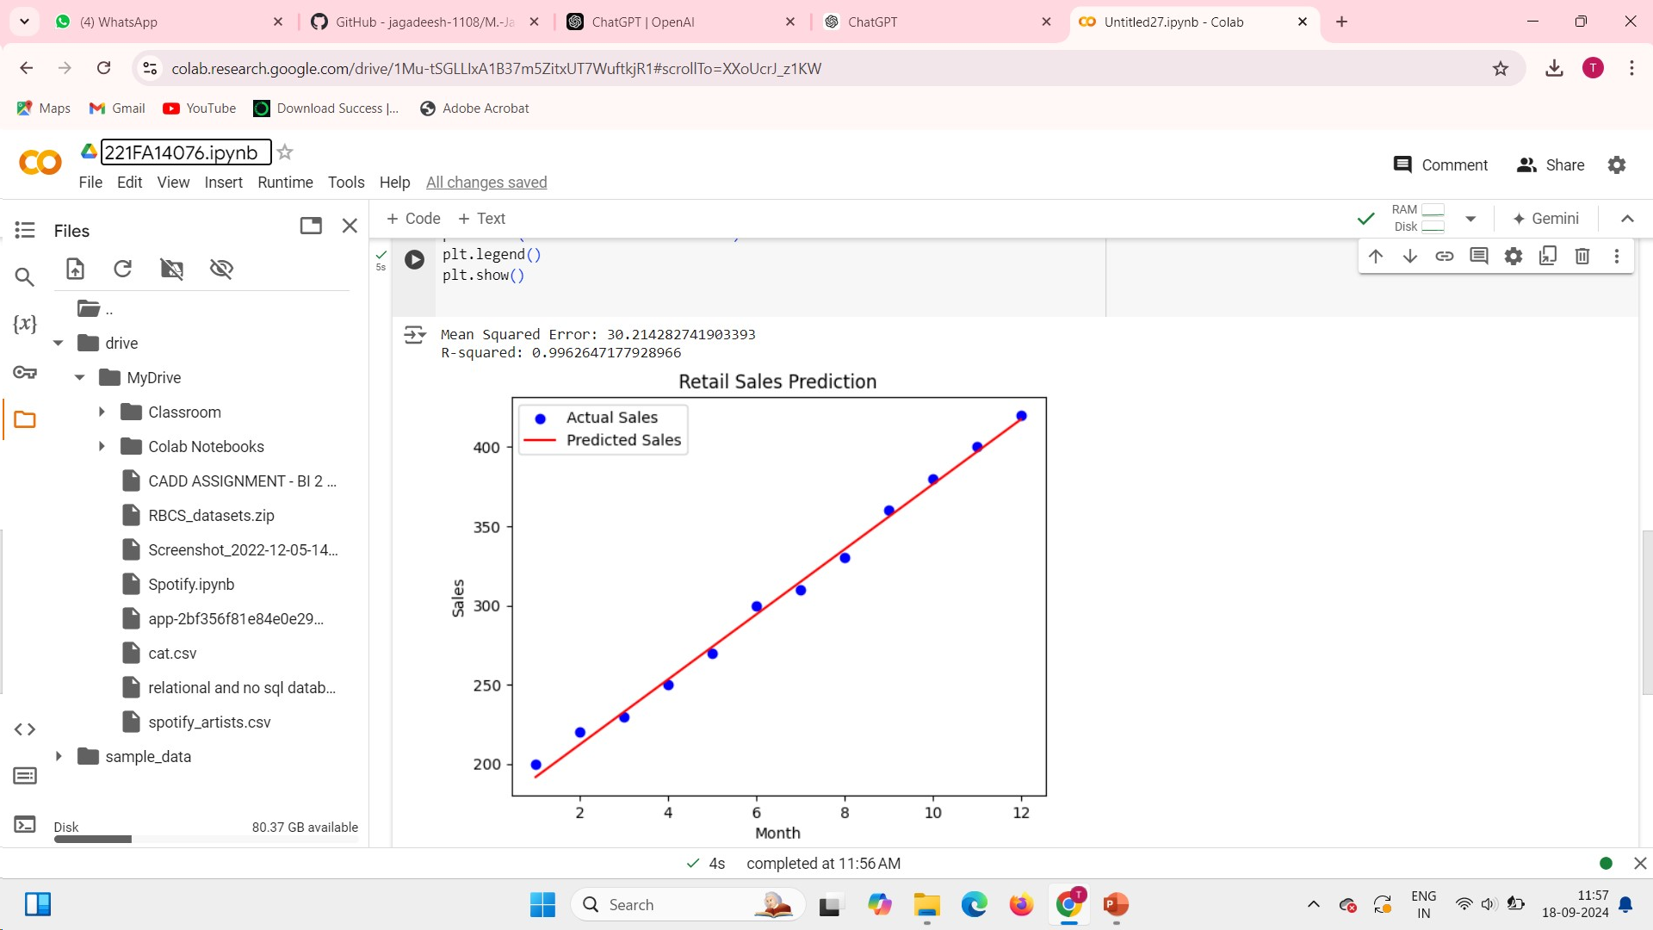
Linear Regression in Python

Slide 7
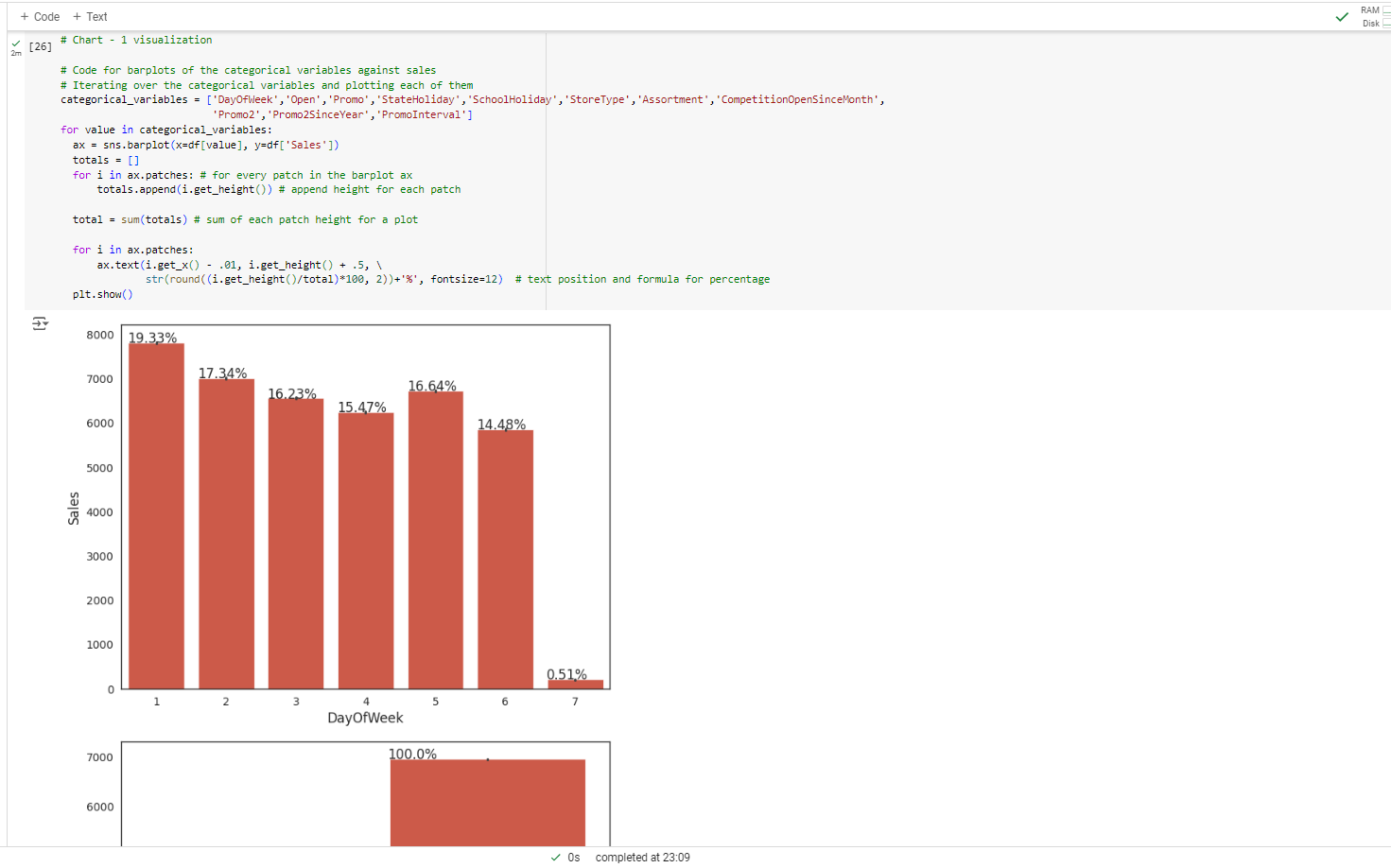
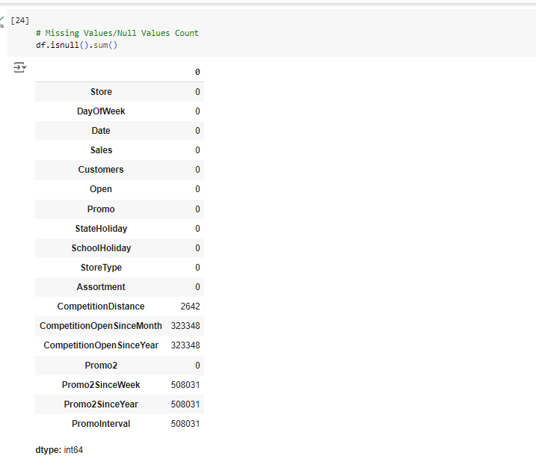
Linear Regression in Python

Slide 8
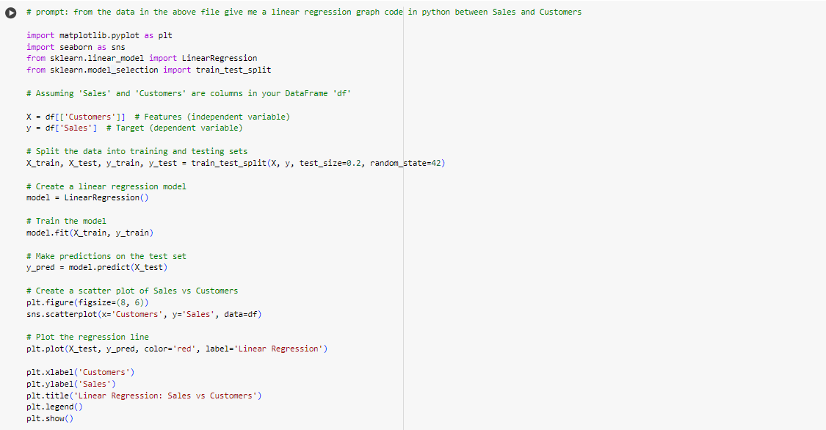
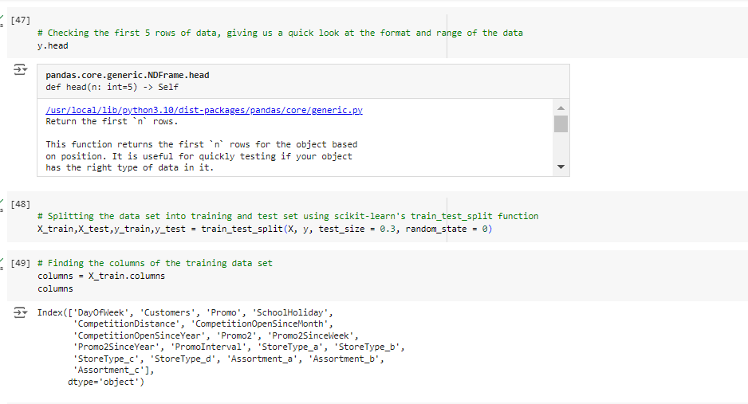
Linear Regression in Python

Slide 9
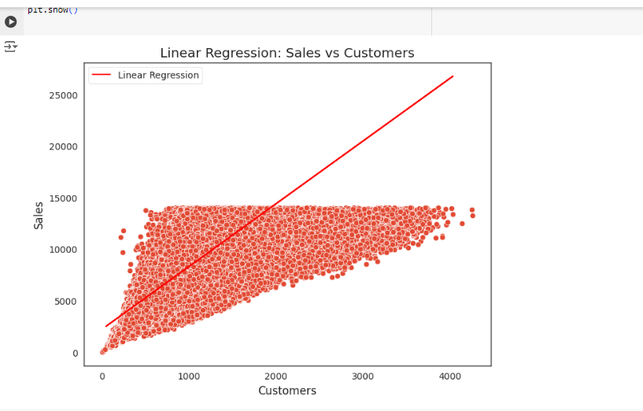
Linear Regression in Python result

Slide 10
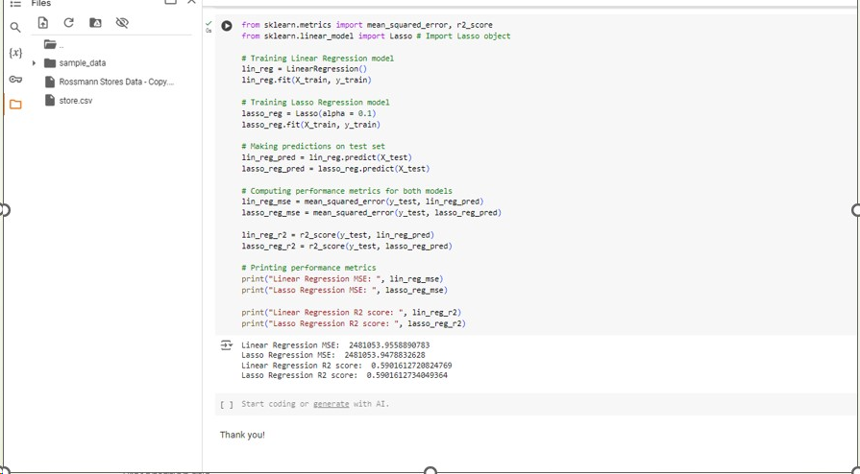
Linear Regression in Python and its R square values

Slide 11
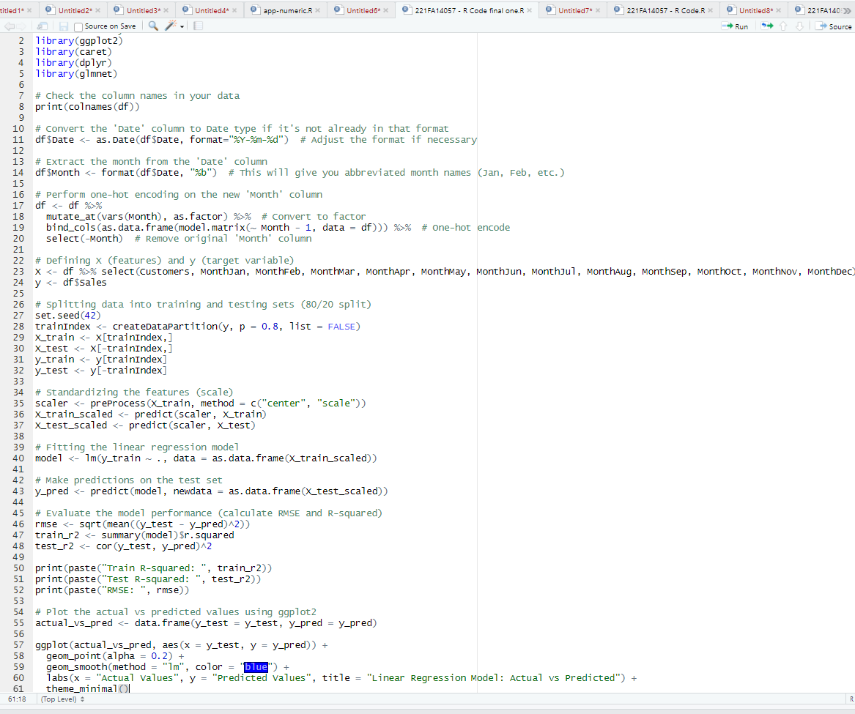
Linear Regression in R and its R

Slide 12
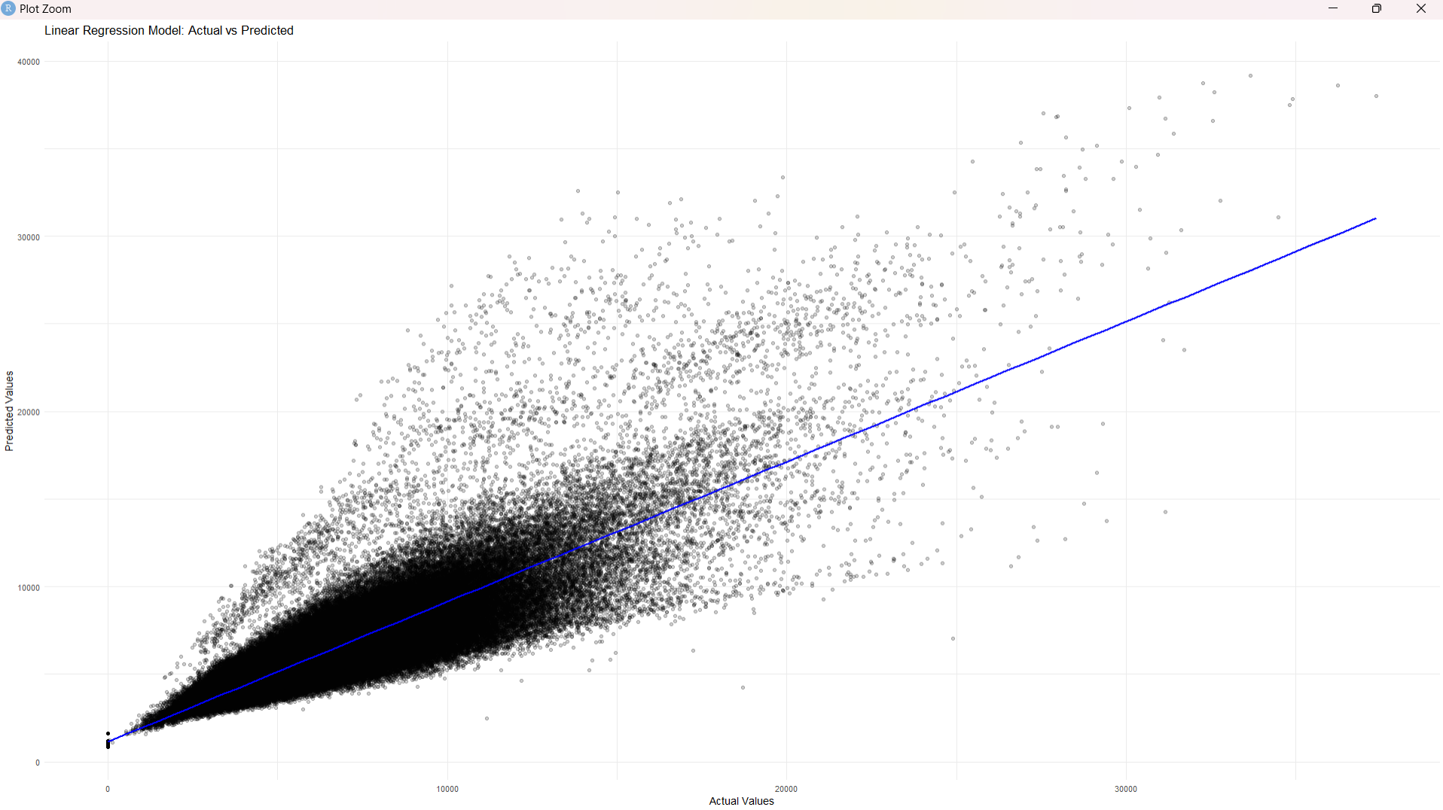
Linear Regression in R and its output

Slide 13
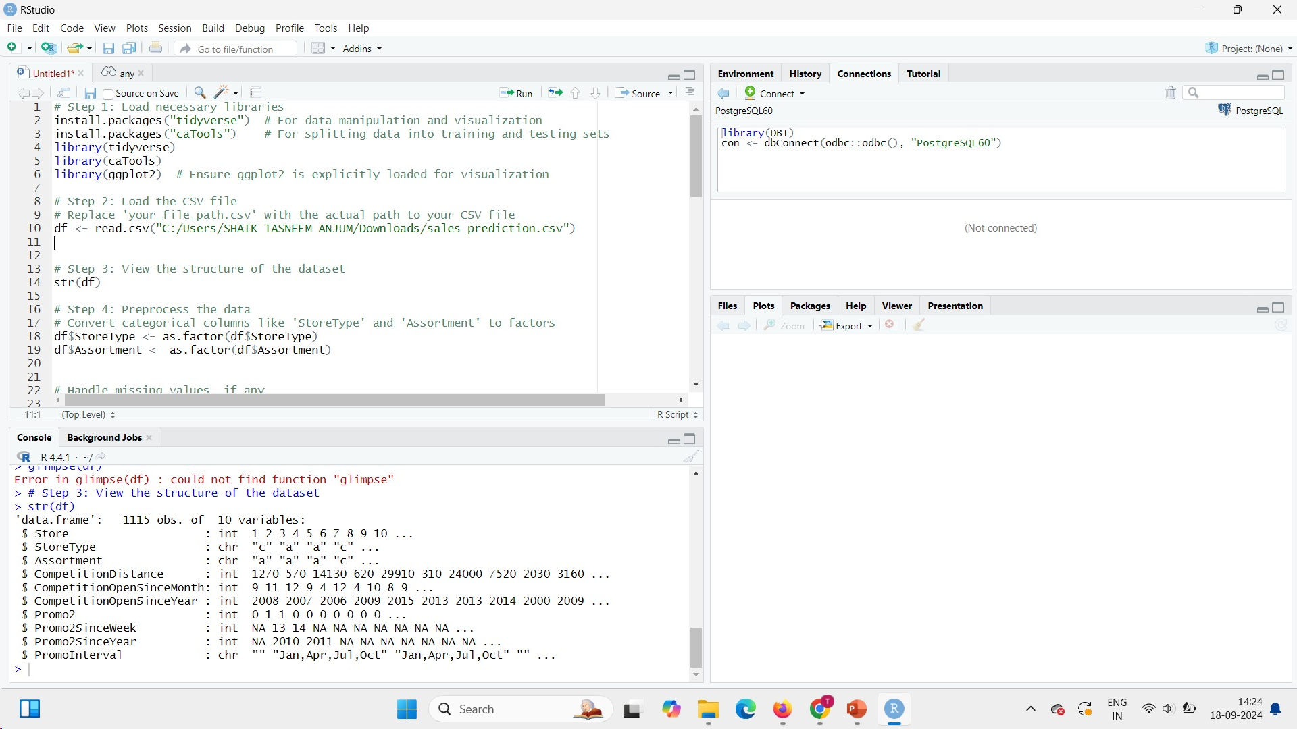
Linear Regression in R and its R

Slide 14
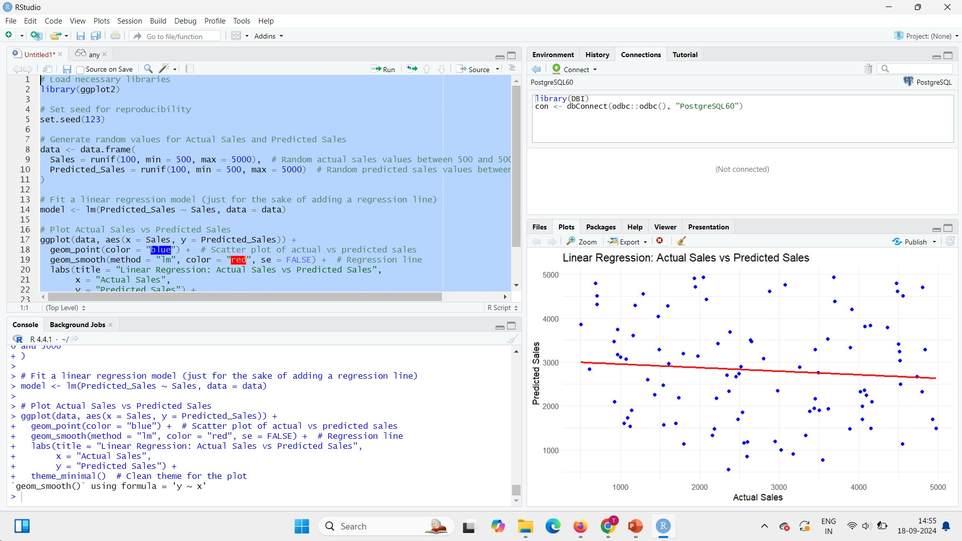

Slide 15

Conclusion
In predicting retail sales using linear regression, both Python and R offer robust methodologies with distinct tools. Python utilizes libraries like scikit-learn for model building and matplotlib for visualization, allowing the implementation of linear regression with functions to split data into training and test sets, and evaluate performance through metrics such as R-squared and Root Mean Squared Error (RMSE). In contrast, R employs the lm() function for linear regression, complemented by ggplot2 for visualization, and provides detailed diagnostics through summary statistics. R also supports data splitting into training and test sets, and performance evaluation using metrics like R-squared and RMSE. Python's ecosystem excels in integration and handling large datasets, while R offers in-depth statistical analysis and rich visualization capabilities. The ultimate aim is to predict the R-squared value in a linear regression model, showcasing the effectiveness of machine learning techniques in R language.

Slide 16
THANK
YOU

